Slide 1
Explaining and Harnessing Adversarial Examples (FGSM)
Ian J. Goodfellow Google Inc.
2020年5月24日

Slide 2
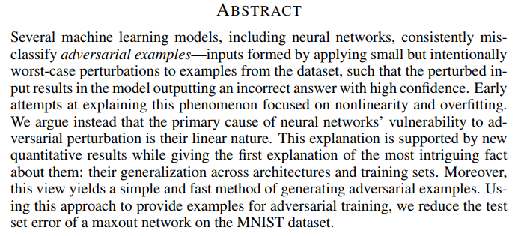
— Explaining and Harnessing Adversarial Examples

Slide 3




The Linear Explanation of Adversarial Examples:
Linear Perturbation of Non-linear Models:
— Explaining and Harnessing Adversarial Examples

Slide 4




Adversarial Training of Linear Models Versus Weight Decay:
Adversarial Training of Deep Networks:
— Explaining and Harnessing Adversarial Examples

Slide 5
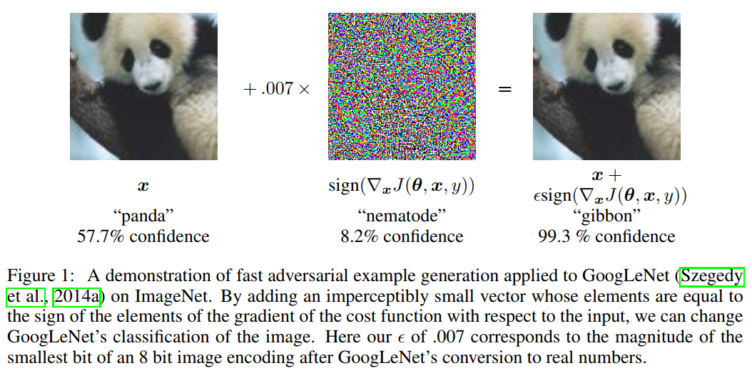
— Explaining and Harnessing Adversarial Examples

Slide 6
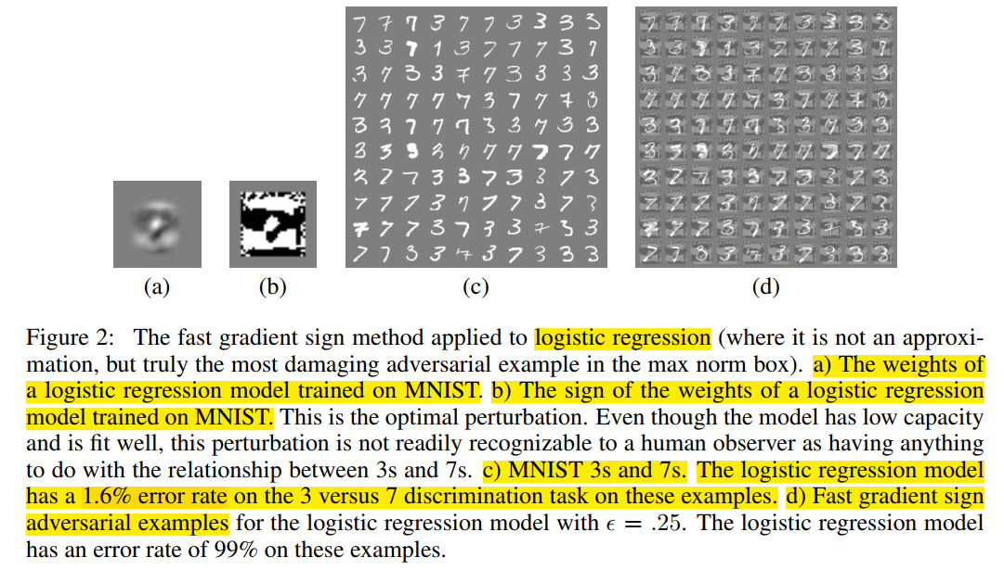
— Explaining and Harnessing Adversarial Examples

Slide 7
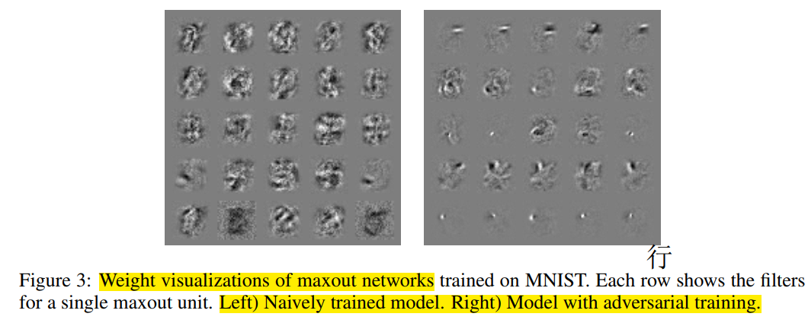
— Explaining and Harnessing Adversarial Examples

Slide 8
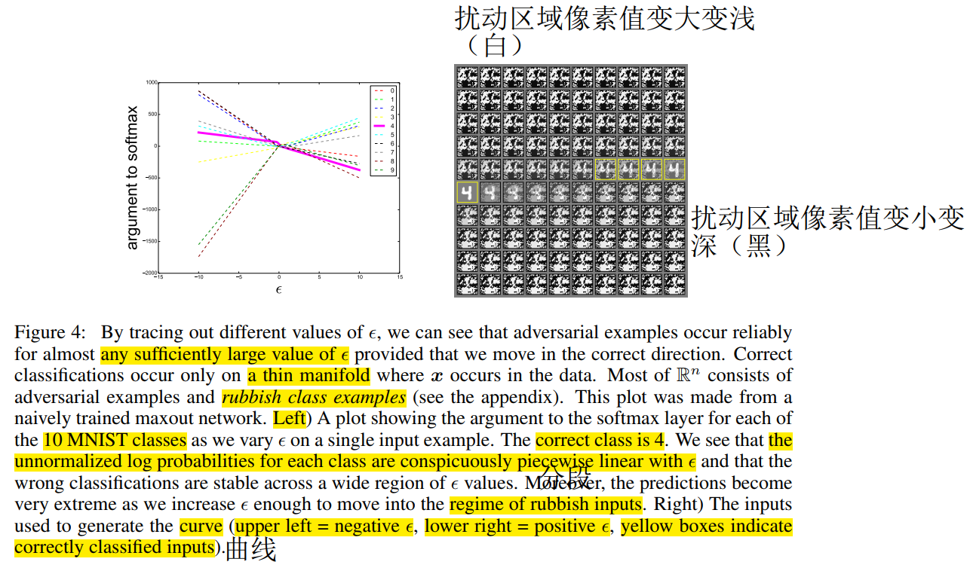
— Explaining and Harnessing Adversarial Examples

Slide 9
总结
抵抗对抗样本的方法：
1.Adversarial training : 增加正则化
2.Ensemble training:增加平均化
3.越易于优化的model（线性特质会使model易于优化）越易被扰动误判，因此增加非线性特质，改进优化器。
对抗样本存在的原因：
1. 网络的线性特质，促使扰动随着维度的增加线性增长
2.判别式model比生成式model抗对抗样本能力弱
— Explaining and Harnessing Adversarial Examples

